Slide 1

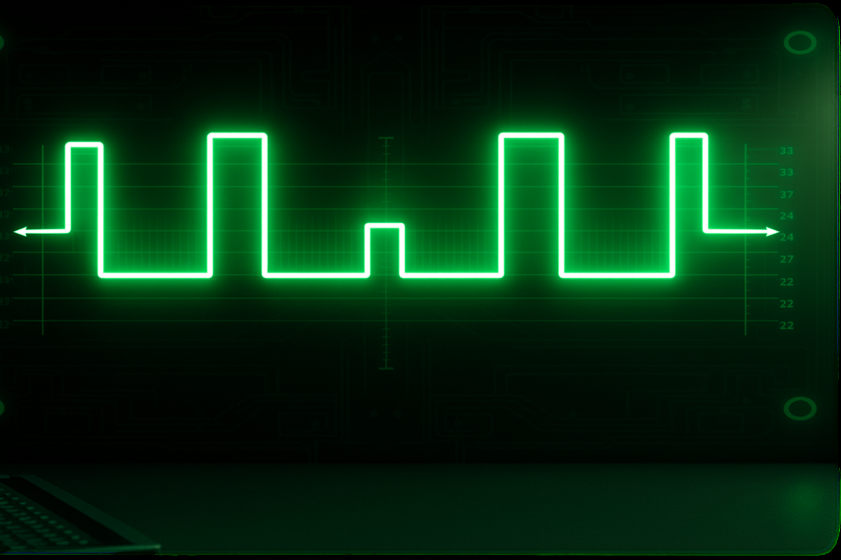
PWM visualization via multi-system representation and data communication system using Socket, UART, and I2C protocols.
Team -
Pritesh Sawant
Sunny Usadadiya
Goli Naga Venkata Sumanth

Slide 2
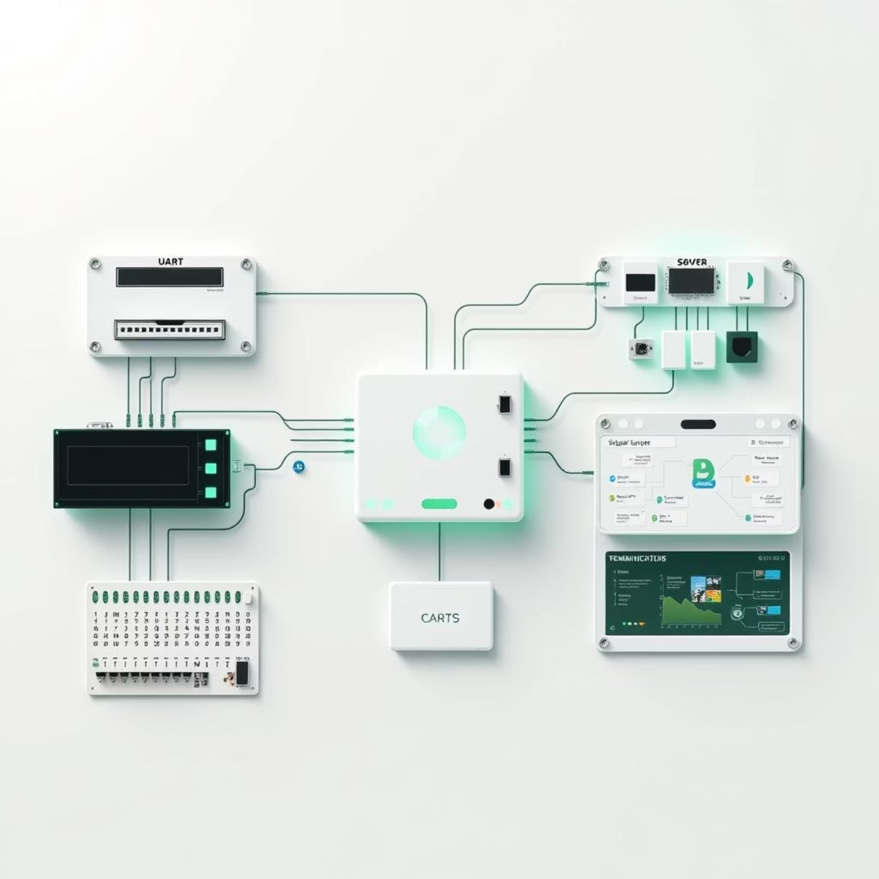
Problem Statement
PWM signals are key in controlling hardware components like LEDs, motors, and buzzers. However, real-time visualization and cross-system debugging in mixed-protocol environments are missing.

Slide 3
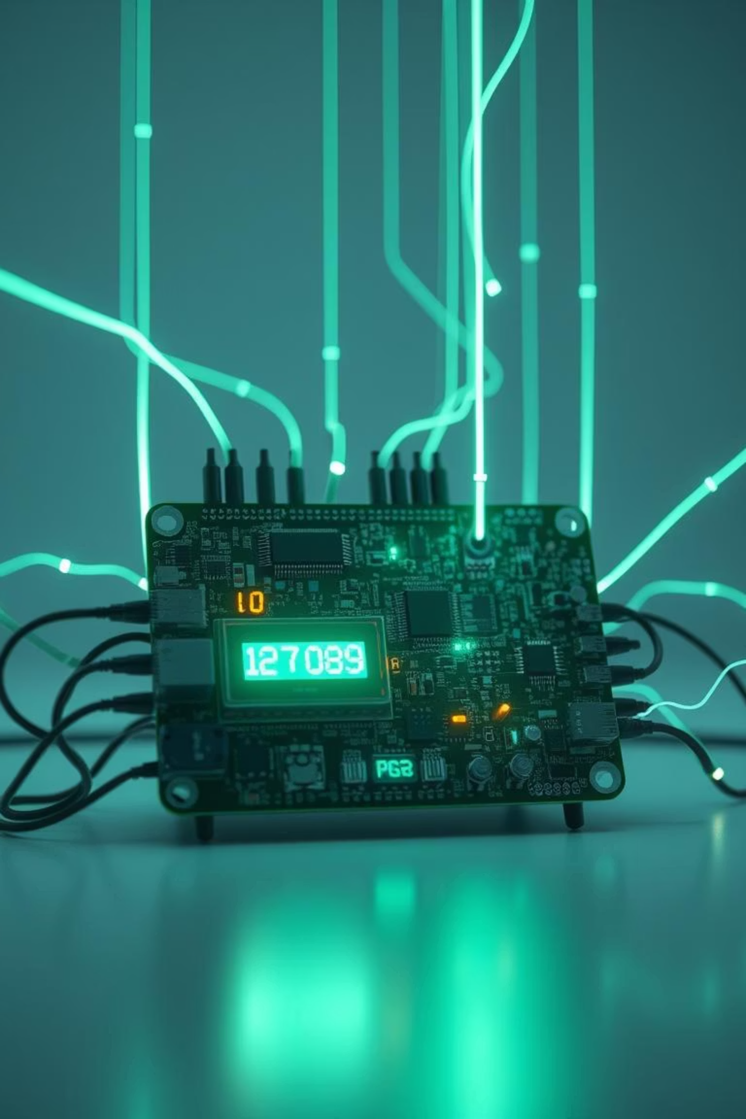





Core Components
x86 System
Logs keypresses 0-9 in interrupt context
Raspberry Pi 4 (BCM2711)
Receives key data via UART, calculates frequency & PWM
Audio Output
Generates square wave 2k-15k Hz
LED Control
Modulates brightness (10%-100% duty cycle)
0.91 SSD1306 OLED Display
Visualizes frequency and duty cycle

Slide 4


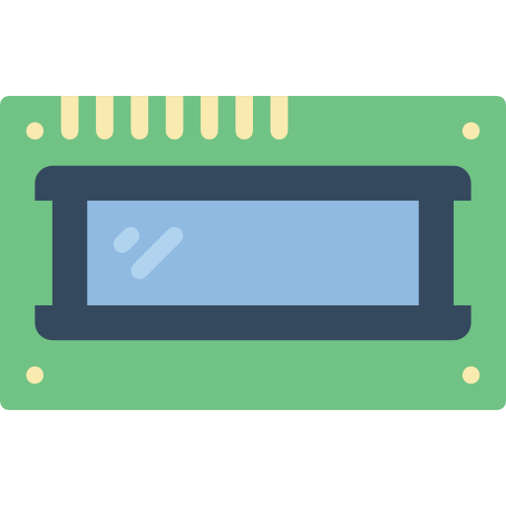


System Overview and Architecture
X86
(Client Sys)
Socket
X86
(Server Sys)
USB to UART
I2C
B C M 2711
( R P I 4)
ALSA
PWM
Audio
0.9 SSD1306 OLED

Slide 5
